Slide 1

How Greenpeace is Entering a new era
Cut the crap, HELP people act

Slide 2

Laura Hilliger | @epilepticrabbit
who am I? Please tell me…
Open Strategist & Idea Maker
http://laurahilliger.com
Earned a Masters of Media and Education in German, despite barely speaking German at the time.
Plays Roller Derby in the German National League.
Works in marketing.
Notes:
Hi, my name is Laura Hilliger, I’m on the interwebz. So when you’re using your social media to tell your networks about all the brilliant stuff I’m about to say, or to make fun of me when I put my foot in my mouth, please do include @epilepticrabbit – you know, feed my ego please.
You know that icebreaker game where you tell two truths and one lie and people have to guess which is the lie? That’s what these bullets are.
How I dress, how I speak, the images I chose for these slides, the places I fumble in this talk – all of this, in combination with these bullet points, is going to help you form a story about me, personally. Your story about me, as is your story about most things, just one side of perception. What you think might not be true, keep that in mind.

Slide 3
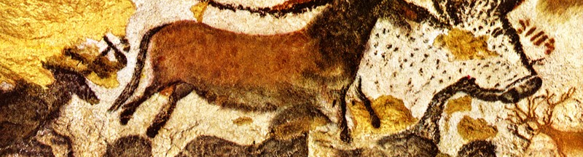
Who made this up?
Stories are a central function of the human mind.
Monday: Beginning of the work week
Tuesday: Taco night
Wednesday: Hump day
Thursday: Afterwork drink night
Friday: TGIF
Saturday: Hangover / Flea Market
Sunday: Rest and hang out with family day
Notes:
Thirty four thousand years ago, in a large cave in Southern France, an artist used pigment to create some of the first known paintings. Herds of bison, charging rhinos, leaping gazelle. The animals - some of them now extinct - were rendered in startling detail. However, these were not simply portraits. The animals were interacting with one another. Interaction is story. Every interaction is a story.
Story is how we remember the past, how we imagine the future, how we create our identities. Stories are how we relate to people. The days of the week are stories we tell ourselves to organize time. Sicknesses are stories scientists make up to explain our mortality. Stories are in everything. Everything has a story.

Slide 4
Story and truth
Stories are a central function of the human mind.
Notes:
Stories don’t have to be fictional or artistic. And they don’t belong to certain kinds of people. Given that a story or narrative is present in almost everything we think, say, or write, theorists often say that after language, it is the most distinctive human trait. Narrative or stories are a central function of the human mind
Think about it – how do you relay information to your family and friends? You don’t submit factual reports with fifteen expert sign offs, do you? No, you tell people stories about what happened, what’s going on in your life.
Greenpeace wants to tell honest stories. Greenpeace is not, nor has it ever been just about the environment nor is it an animal rights organization. Our mission is to have a green and peaceful world. As a non-profit with a mission to protect the planet in all it’s biodiversity, the stories Greenpeace tells aims to put the ecological movement on an equal playing field with forces that have more resources.
So we use our own story as a tool to access power.

Slide 5
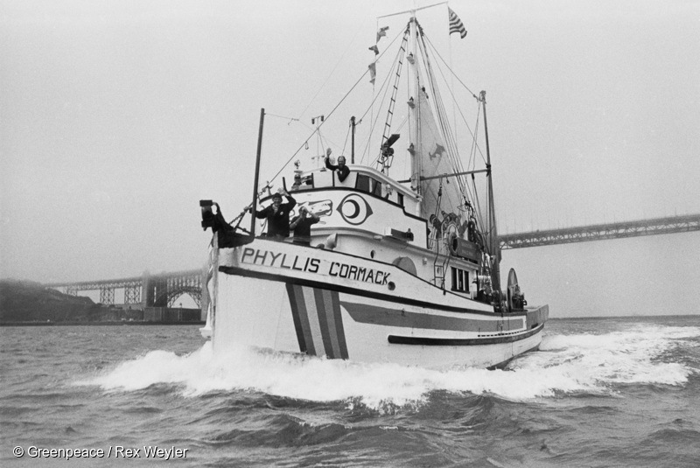
Greenpeace began with a ship and an action
Bearing witness and an obligation to act
The golden rule – do unto others
Nonviolence
Notes:
Greenpeace has a powerful story, and Greenpeace has always used media to create power. And it’s always done so using social networks. Before GP was an organisation, an office, a brand or a movement - it was a ship and an action. The super short version of this founding story goes like this:
In the early 70s, the US government wanted to test a hydrogen bomb on a small island off the Pacific Northwest coast called Amchitka. Some folks from Vancouver learned of this test and started protesting – their first argument was quite simply that no one knew what testing a nuclear warhead would do to life on or under or around the island. People worried about causing a title wave. They worried about radiation poisoning.
These concerned citizens were inspired by Quaker principles and they formed the “Don’t make a wave committee”. They protested in the streets, they talked about their concerns to others. They formed networks of people. More people became concerned, but the US Defense department showed no signs of canceling the test. These rabble rousers were’t going to give up. The Don’t Make a Wave Committee decided to take a ship to Amchitka and protest the US nuclear testing at the site. They threw a benefit concert, raised money and leased a small fishing trawler called the Phyllis Cormack.

Slide 6
how Greenpeace went beyond brand and became a movement
“The only delivery system we had which could possibly fend off the military’s nuclear weapons delivery system was the mass media. Our idea was that we would fire off press releases instead of ballistic missiles. So in a way this little old fishing boat became a kind of media battleship.”
Bob Hunter, ca. 1971
Notes:
The other thing this group of citizen did, though, the thing that the newly formed Greenpeace did that set a chain of events in motion that would lead to the Environmental movement as we understand it today, was storytelling.
The founders of Greenpeace had an visceral understanding of how to use mass media to tell an inspiring and engaging story.
The images and the stories of a group of ragtag activists sailing towards a nuclear testing site to protest spread around the world. Bob Hunter, one of the founders, said the image the story was a “mind bomb” – a story designed to shift perspectives.

Slide 7
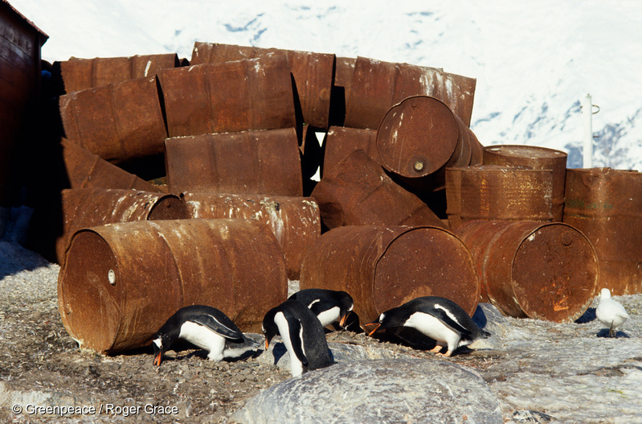
Notes:
Here’s another mind bomb
Working with ships has allowed Greenpeace to go to places that most people can never go and to witness environmental crimes/injustice that would otherwise never be seen.
Because we are there – we are impelled to take action. Because others bear witness with us – we hope that they also are inspired to act.

Slide 8
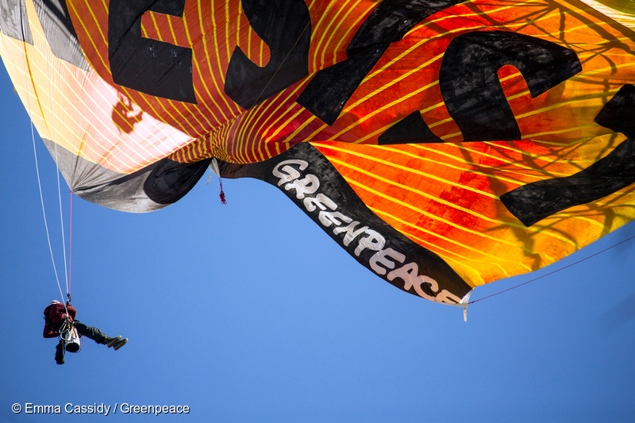
how Greenpeace went beyond brand and became a movement
Is about courage
Is about solidarity
Is about activism
Notes:
When people think of Greenpeace, often what they think of is daring individuals showing physical courages. An activist standing boldly in the path of a bulldozer in a political or moral act. A climber hanging above raging waters showing solidarity for a specific cause.
Our brand goes beyond “saving the environment” and engages people through a vision of an activist lifestyle. People think if you’re involved with Greenpeace, you must be a rebel, a lawbreaker, a force against the status quo.
They think this because a: it’s true, Greenpeace is full of daring and courageous individuals. And 2: We spread iconic images and stories.

Slide 9
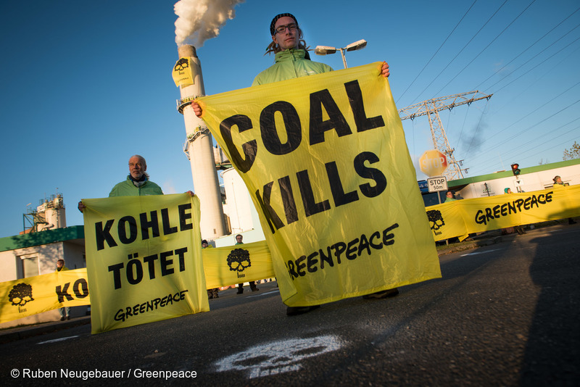
Our negative narrative: Emotional vs Rational
We all know the characters and conflicts of the Environmental movement
Doom and Gloom isn’t helping
The apocalypse is going to be caused by zombies
Notes:
The story of the environmental movement is one that many people now are familiar with. The setting: our world, the characters: huge faceless corporations who care for nothing except money, annoying environmental activists who expect everyone to be a vegan. The idiotic, consumption obsessed public, unaware of either the greed or the planetary destruction. We know the conflicts.
This story is set up, ingrained in us, even if people have different views on the issue itself.
Over the years, Greenpeace fell into a kind of doom & gloom narrative. When people think of the environmental movement, they think about death, destruction, mayhem. The end is coming, we’ve been telling our stories as if they’re supposed to be part of the apocalyptic genre. Think about how I described the characters – faceless, annoying, idiotic. We’ve been telling stories as if the characters are all bad.

Slide 10
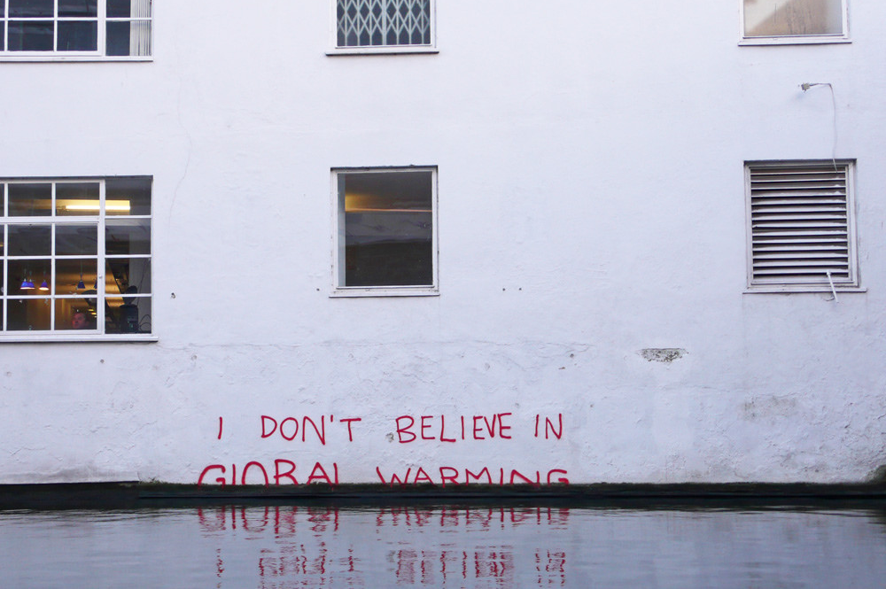
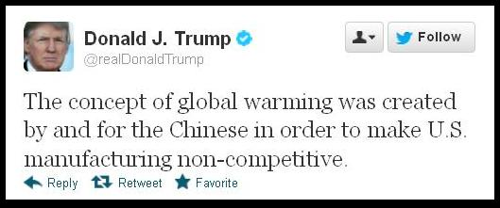
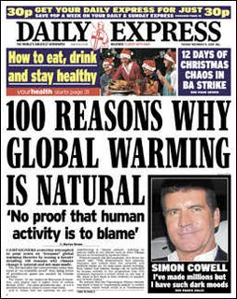
Our negative narrative: Emotional vs Rational
Progressives have emphasized science & rationality
Our opponents have relied on emotional arguments
Notes:
This narrative is powerful and wide-reaching. We’ve been using it for years. But it’s a shallow triumph because critical voices who deny climate change and push ecological boundaries past their limits are still loud.
Ideological disagreements about climate change have paralyzed global action (both in terms of government and ordinary people). Progressive activists have in the last few decades, especially with regard to climate change, tried to make arguments with a heavy emphasis on science and rationality. While our opponents have chosen to frame their narratives in doubt, rumors, emotional appeals etc.
Our opponents frame their arguments in terms of loss of freedom, loss of prosperity. For example, although there are much cleaner, more efficient and safer ways to produce energy than burning coal, proponents of coal simply say “Why are you trying to take away blue collar jobs!?” and no one cares that we don’t really need to use coal anymore. They use emotional arguments that hit close to home. They use fear of inconvenience or fear of losing status to make us buy things and consume things with total disregard for what our consumption does to the planet.

Slide 11
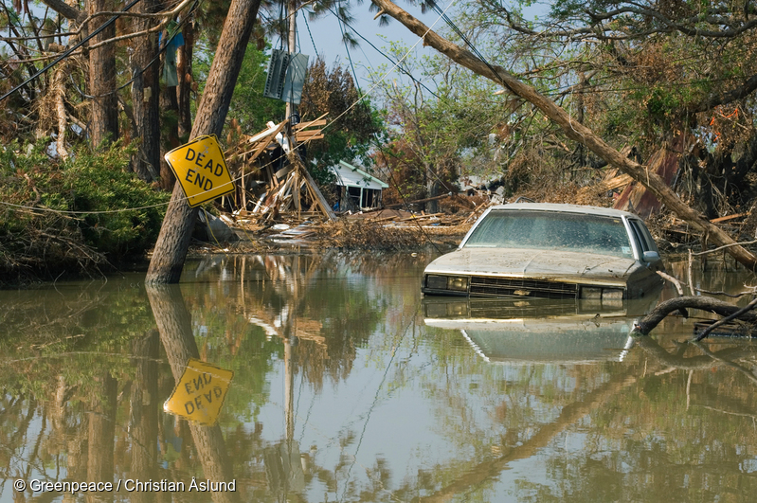
Behaviors shape our world
Greenpeace has a history of using rational arguments. But even the truth needs storytelling.
Power belongs to those who shape the conversation
We’re all in this together.
Notes:
Meanwhile, environmentalists have tended to frame our ecological problems in rational terms: loss of biodiversity, over proliferation of chemicals. Greenpeace has a history of using rational arguments. Facts, figures, reports. We tell people what to do – stop this, stop that. We haven’t provided emotional context. We used to think truth in this way was the answer. And it is. But even the truth needs storytelling. We can’t just expect that the most compelling facts will win. We learned that our audiences needed to become broader.
People have become so overwhelmed with messages on what they should care about, they’ve lost site of what they should, actually care about.
The power dynamic lies with those who shape the conversation. Corporate advertisers are telling the story that we will be prettier, smarter, better if we just keep buying new stuff. But community and engagement are not the same as customers and service. We are using our brand to ransack corporate bullshit and propose a different vision of our collective future.

Slide 12
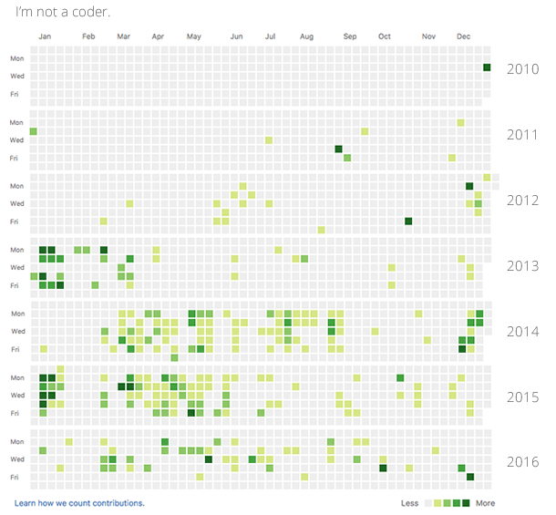



A new story: Cooperative and Open Source
Notes:
Like all of you, I was taught a story of individualism. That I had to make my own way. That I would have to struggle to survive. That I had a particular path to follow. To compete, make money, climb the corporate ladder. That this is normal. The way it is. Success is richness and fame and there’s only one way to get there. People can’t be trusted. Being smart isn’t enough, that I would have to “adapt” to fit in. I was taught that no one was going to help me. Stranger danger.
But somewhere along the way, I learned another story – that no matter what, I can choose to be strong, fierce, independent. Through my friends and family, I learned that people would help me. I learned that the world is nuanced. The kindness of strangers.
And I spent my career making decisions not based on money or power, but based on ideals and ethics. And I think I’m “successful” because of that, not in spite of it.
“Learn to fit in” and “be yourself” is not a dichotomy. We are taught conflicting ideas all the time, and we have free will – we have a choice in what we do. Our structures can be changed, and we see that happening around the world. Capitalism is not the only way. Competition is not the only way.

Slide 13
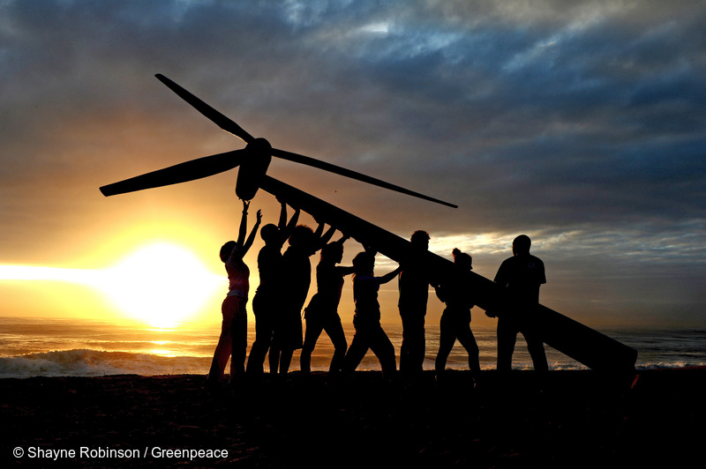
Our new story: Theory of Change & what it means To our brand
Greenpeace wants to provoke hope
We can create positive change
People everywhere are already living this dream.
Notes:
At Greenpeace, we realized that we needed a new narrative for the environmental movement. One that is as powerful as the modern story of individualism.
We dream of a future that is a balanced, modern, utopian narrative of social progress and renewal. What we want is to provoke hope -- especially for the story of climate change, which has seemed doomed because of its emphasis on the apocalyptic genre.
We need to tell a story of a visionary species. A romantic journey of change and human agency and power. The story of a girl who was taught she had to “fit in” and outright refused – where the girl is “all humans” and the journey is from a system and a planet built on competition and to a system and a planet built on cooperation.
Everywhere there are people already living our dream. We want to change the perspective that Greenpeace is purely “environmental” and help people recognize the interconnectedness of the environment and other issues. We have a broader story about humanity to tell.

Slide 14
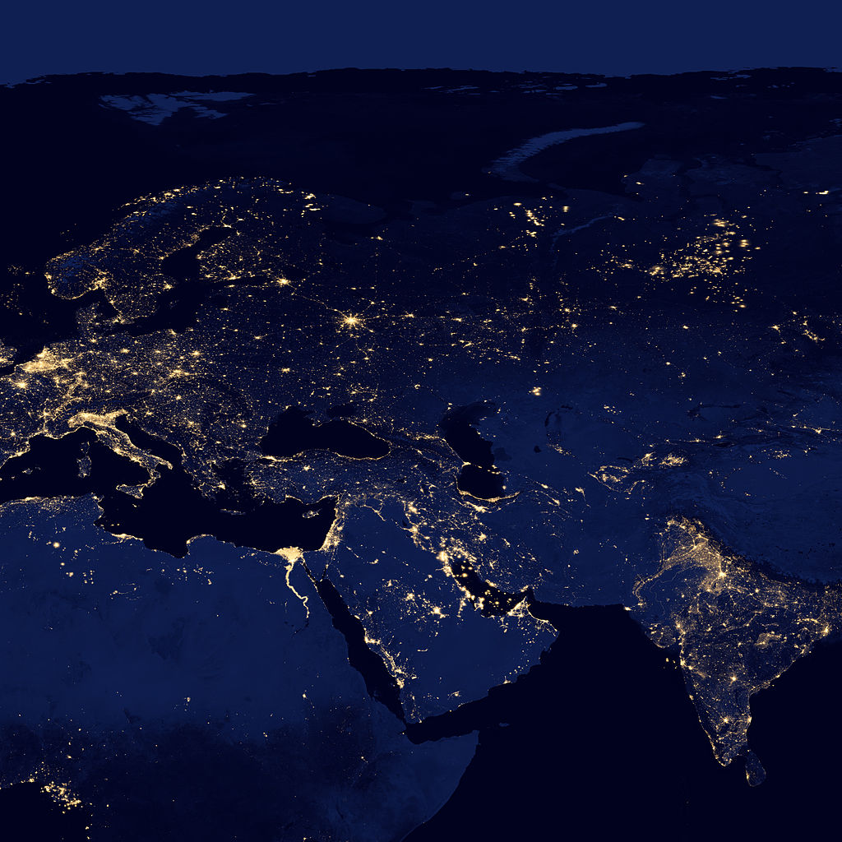
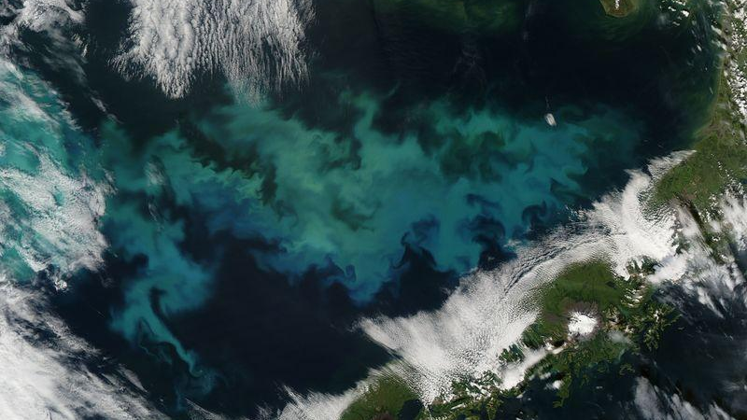




Planet 4 is an Engagement Platform
Greenpeace has your back
People power is social
Clear vision leads to decisive action
Change is everywhere
Notes:
Which brings us to Planet 4. Planet 4 is the code name for the engagement platform we’re building at Greenpeace. Greenpeace has the reputation to inspire change, and we’re looking to use technology to support the type of cultural shift that needs to happen to protect our planet.

Slide 15
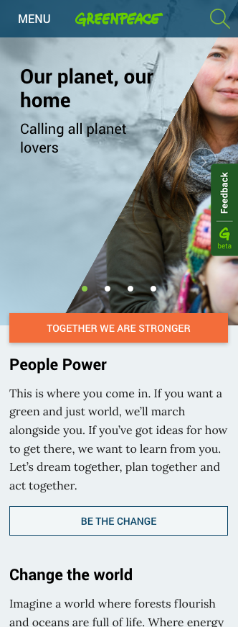
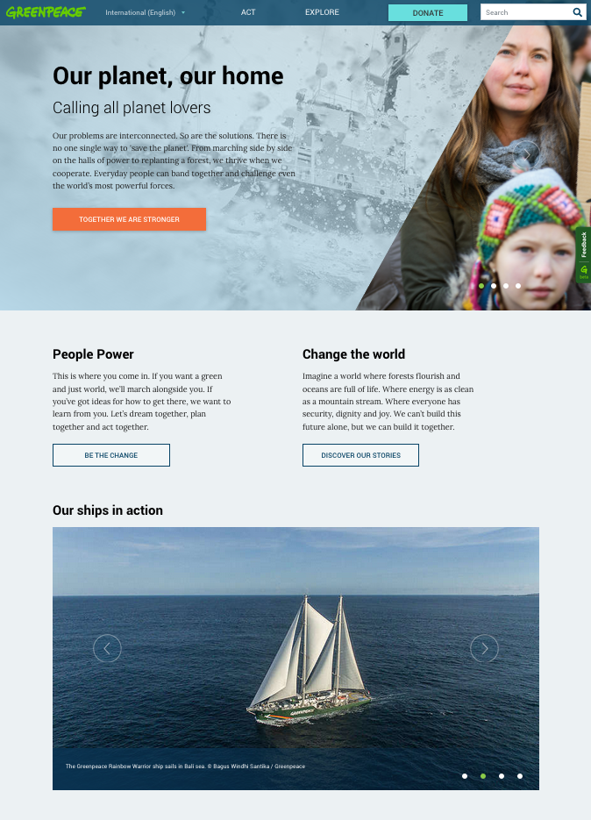
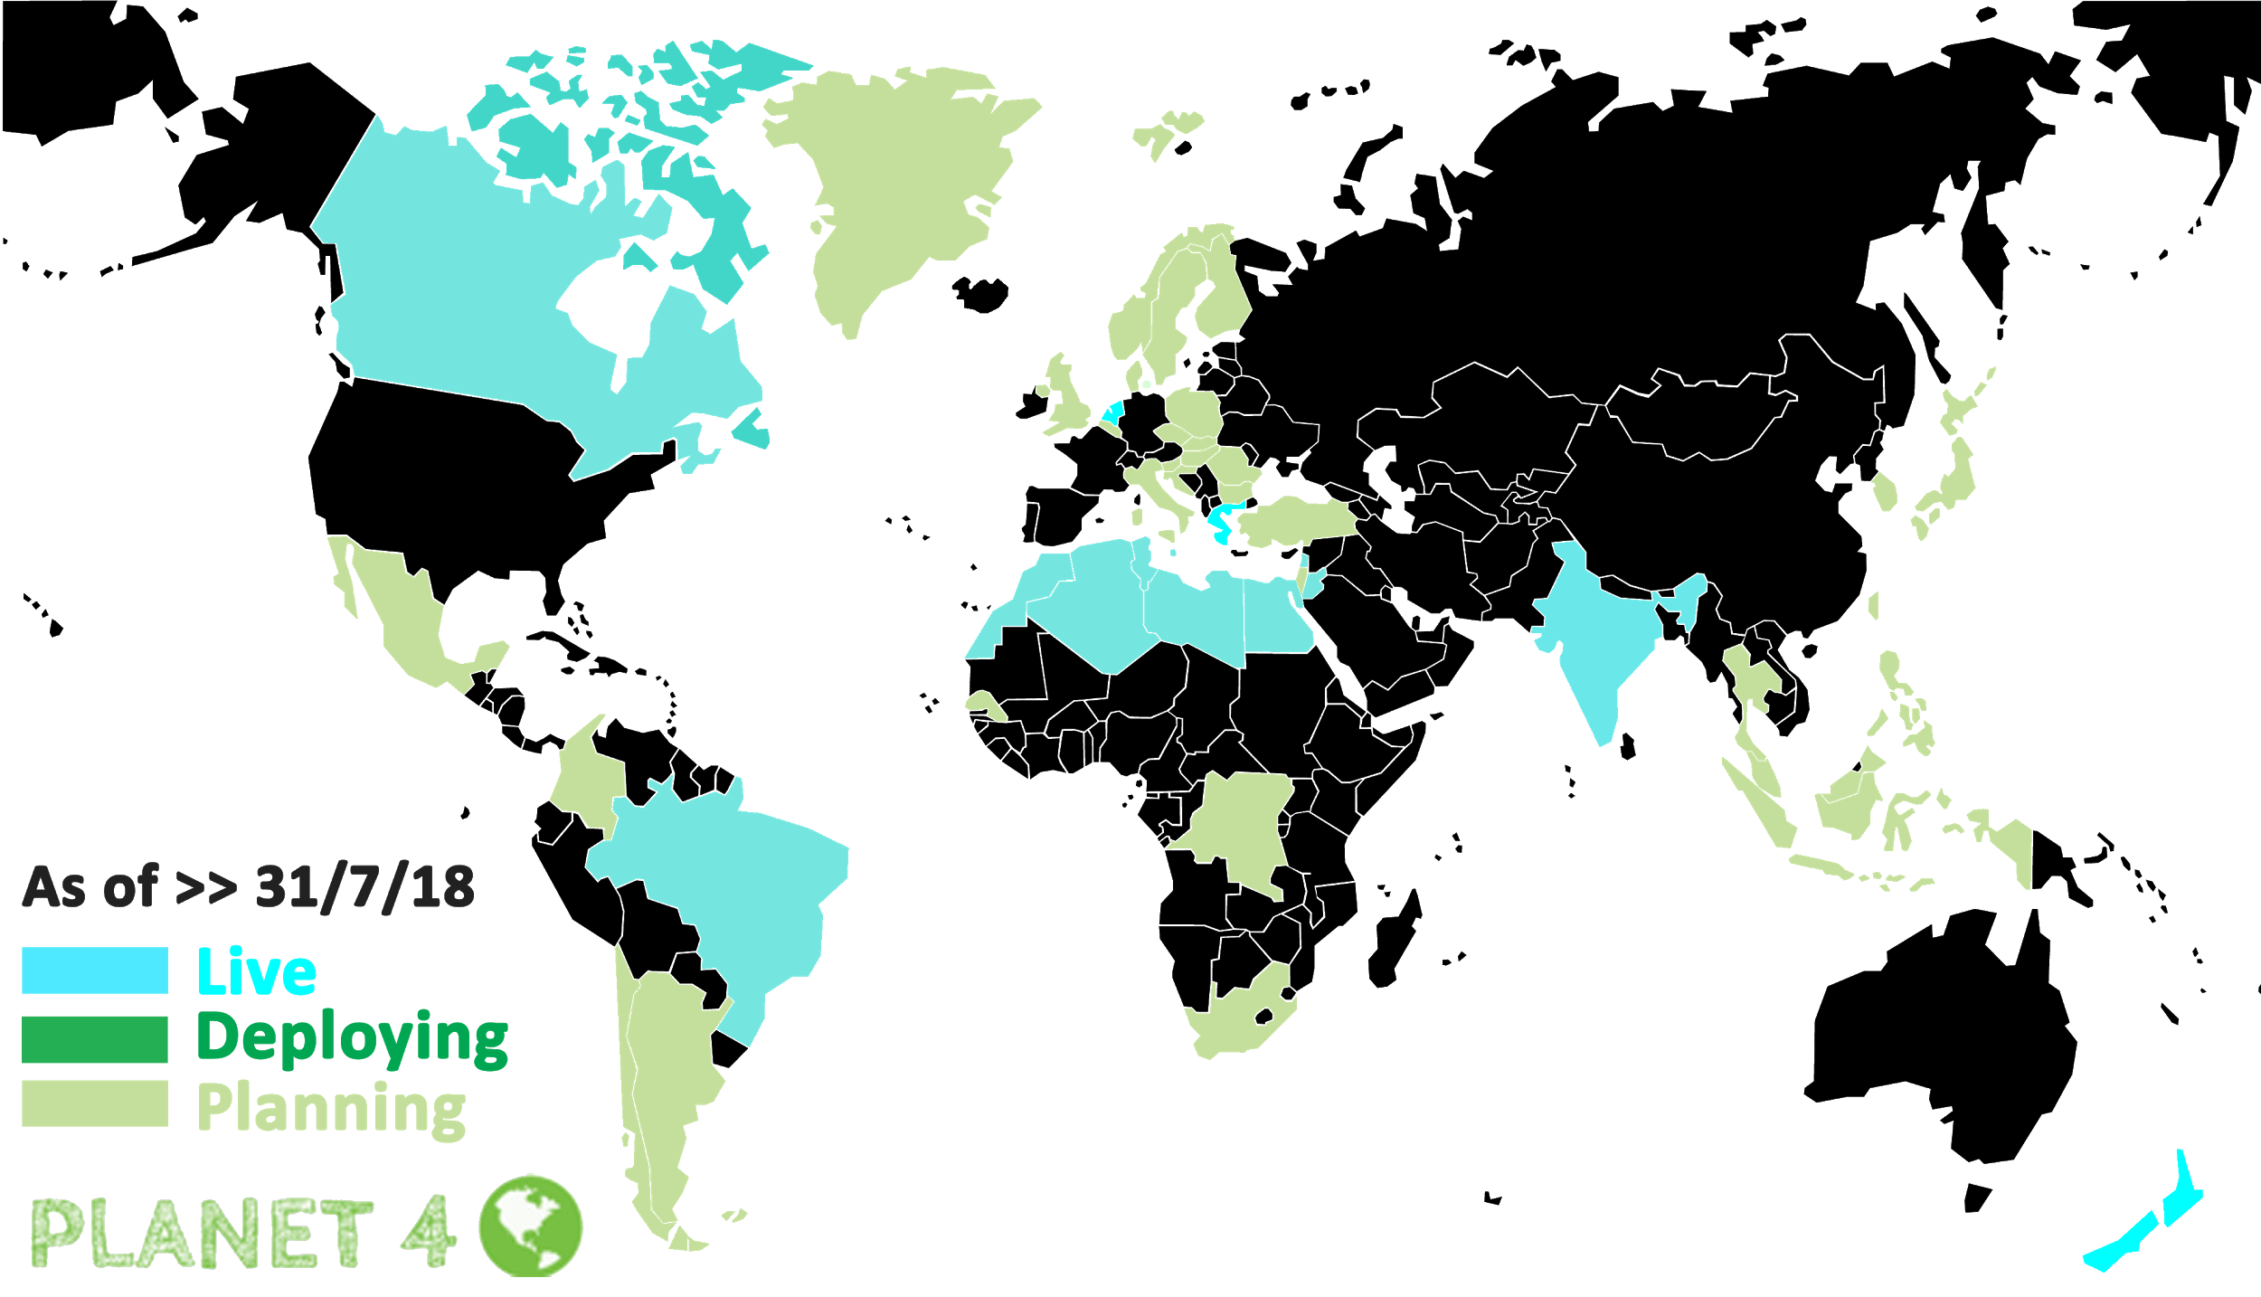
Planet 4: The new greenpeace.org
Planet 4 = the CMS behind global Greenpeace sites
It’s an engagement platform
Notes:
You can see Planet 4 in action right now. We’ve rolled out 7 countries, so you can go to Greenpeace International or Brasil or Canada, New Zealand, the Netherlands, India or Greece and see it in action
Eventually it will run GP domains around the world, for 52 countries, countless campaign sites. It is huge.

Slide 16
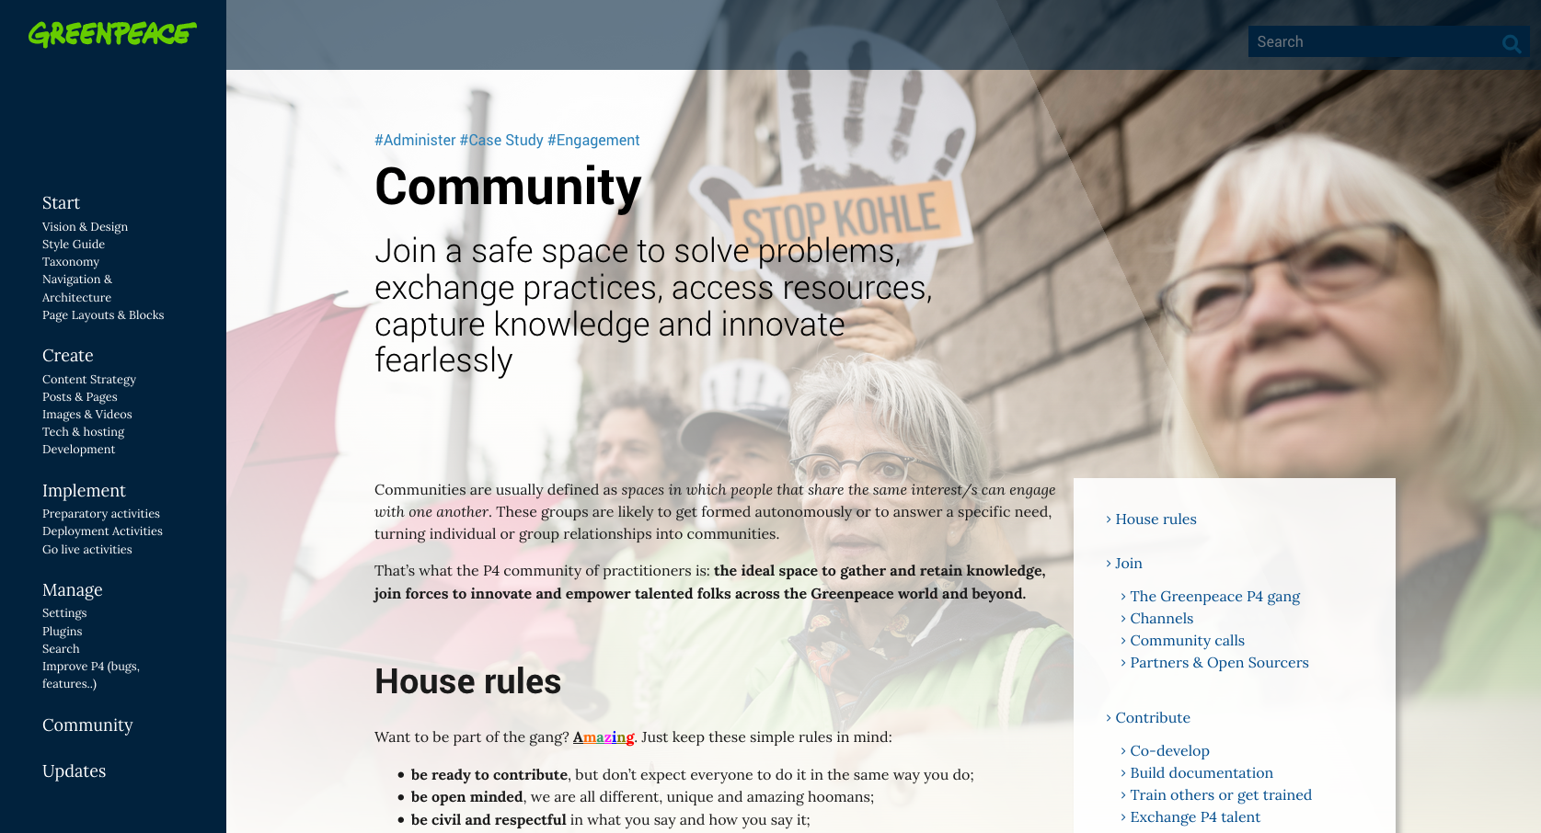
Notes:
It’s even running our Handbook site, a set of documentation and a conversation space for staff and volunteers working directly with the platform.
Planet 4 is about community: Building community is something that happens when you design your project for participation.
From the beginning, the Planet 4 team has been working openly.

Slide 17
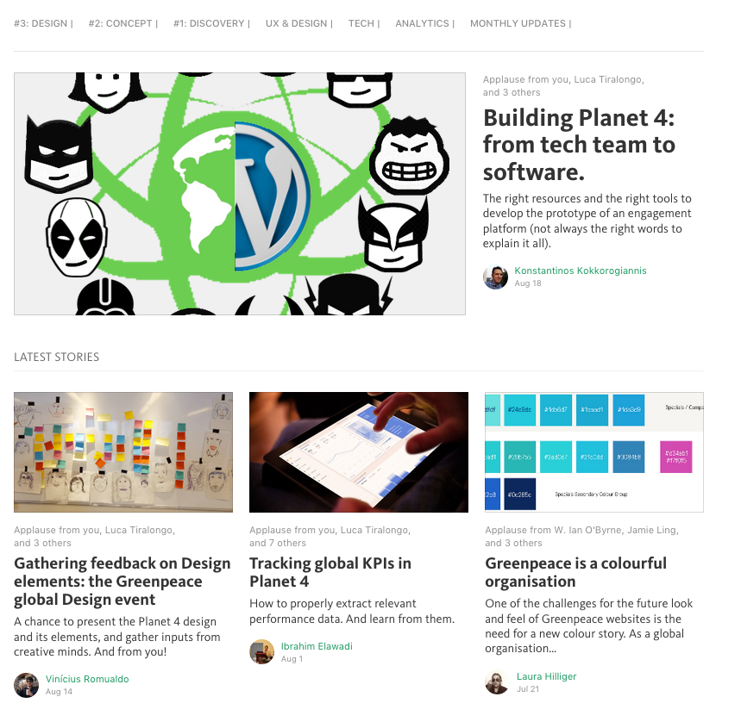
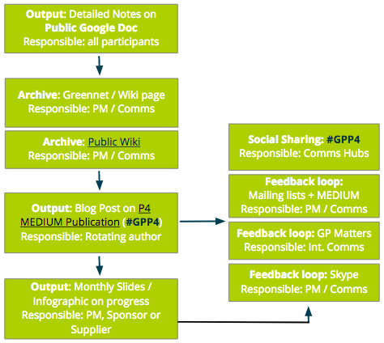
Planet 4: community driven
greenpeace.org/p4
medium.com/planet4
opensource.com/users/laurahilliger
Notes:
We have a Medium publication where you can learn everything there is to know about building an engagement platform, designing an online brand, and working in a remote team.
We have been transparent and inclusive. Our posts don’t run through a marketing department, we’re not spinning the process. I’ve even written articles about team dynamics and bringing open processes to Greenpeace on Opensource.com.
We invite people to community calls, we run surveys, we ask people what they think before we’ve finished things. We release early and often.
We use decentralized leadership, decentralized decision making, decentralized processes to make sure that we are building something not just for, but WITH, our global community.

Slide 18
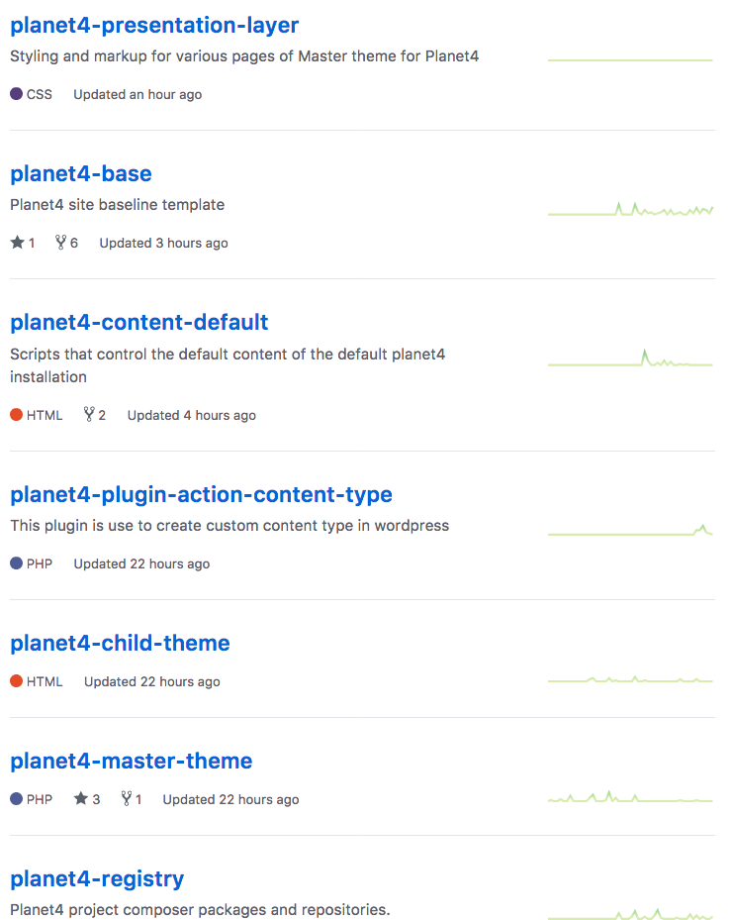
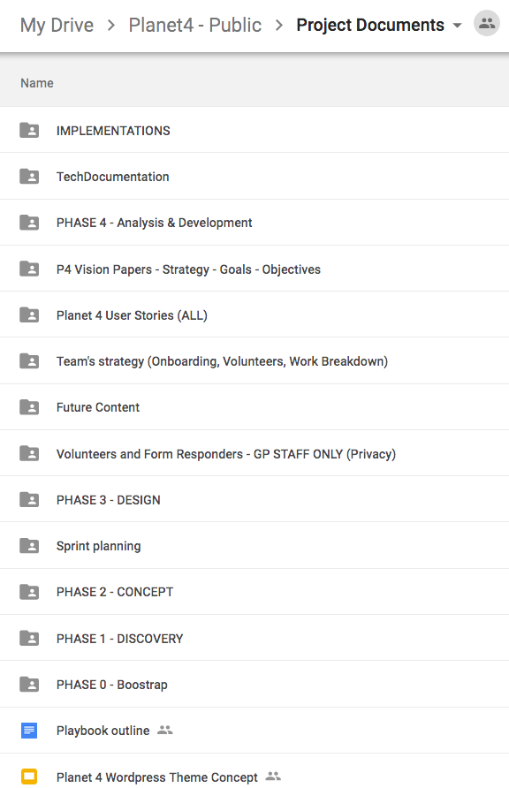
Planet 4: open source
Transparency
Decentralization
Hackability
Notes:
P4 is open source. From our planning documentation, decision structures, from our release cycles and code – everything about this project is open source.
What if you had to ask permission to wear your favorite belt with your favorite pair of jeans because they weren’t made by the same company? Or if you had to contact Coca-Cola and Captain Morgan‘s every time you wanted a rum and coke? Giving people the ability to make decisions about how they use our work and what they do with it leads to innovation, especially when people have the ability to remix (hack) what someone else already created.
As part of a series of organizational changes, Greenpeace aims to share knowledge and expertise in a way that allows others to remix and reuse.

Slide 19
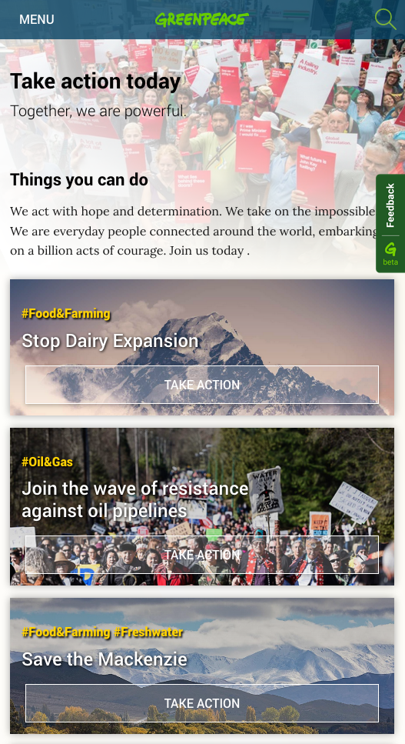
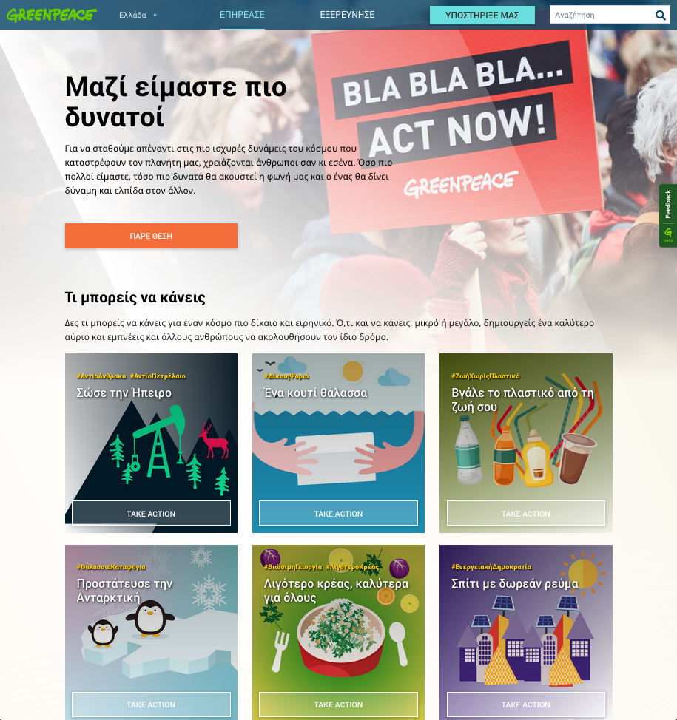
Planet 4: Engagement Platform
Empower people to take action
Follow issues and campaigns
Notes:
3. Planet 4 is an engagement platform. It isn’t designed to shout information and facts at a global audience. It’s designed to tell stories and empower people to take action. By inviting people to follow projects they are interested in, and save things to their Action List, we will invite people to learn and act on behalf of our planet.

Slide 20
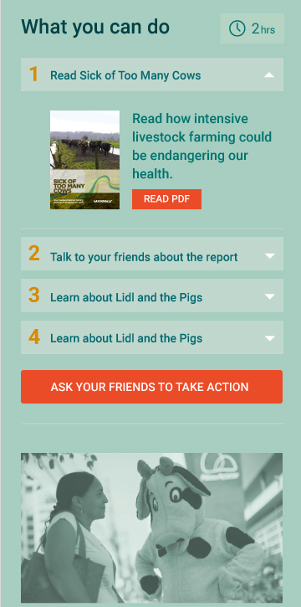
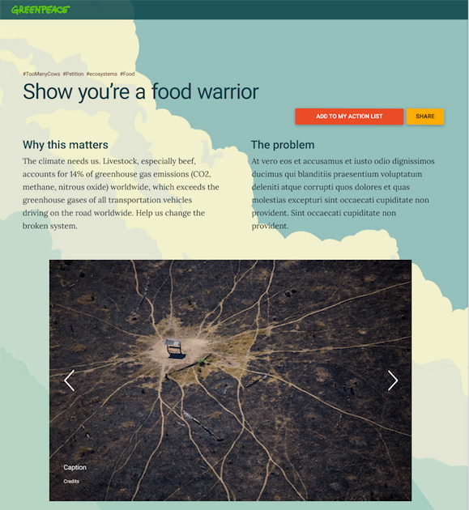
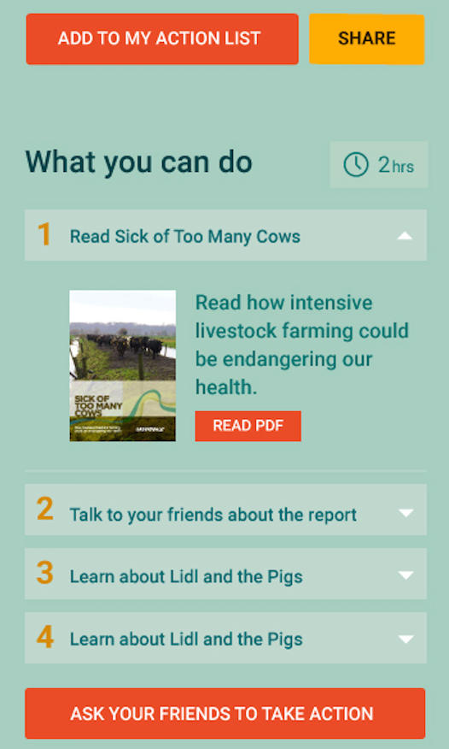
Planet 4: Engagement Platform
Highlight interconnectedness
Be an active citizen
Notes:
This has huge implications for how Greenpeace tells stories and creates content. Greenpeace campaigns will look at what people can do to impact change. Our content will aim to be holistic and convenient, meaning that we will highlight the interconnectedness of social and environmental issues and try to help people make their own lives better.
We will give people the tools to act on behalf of our planet, and redefine what it means to be an active citizen.

Slide 21
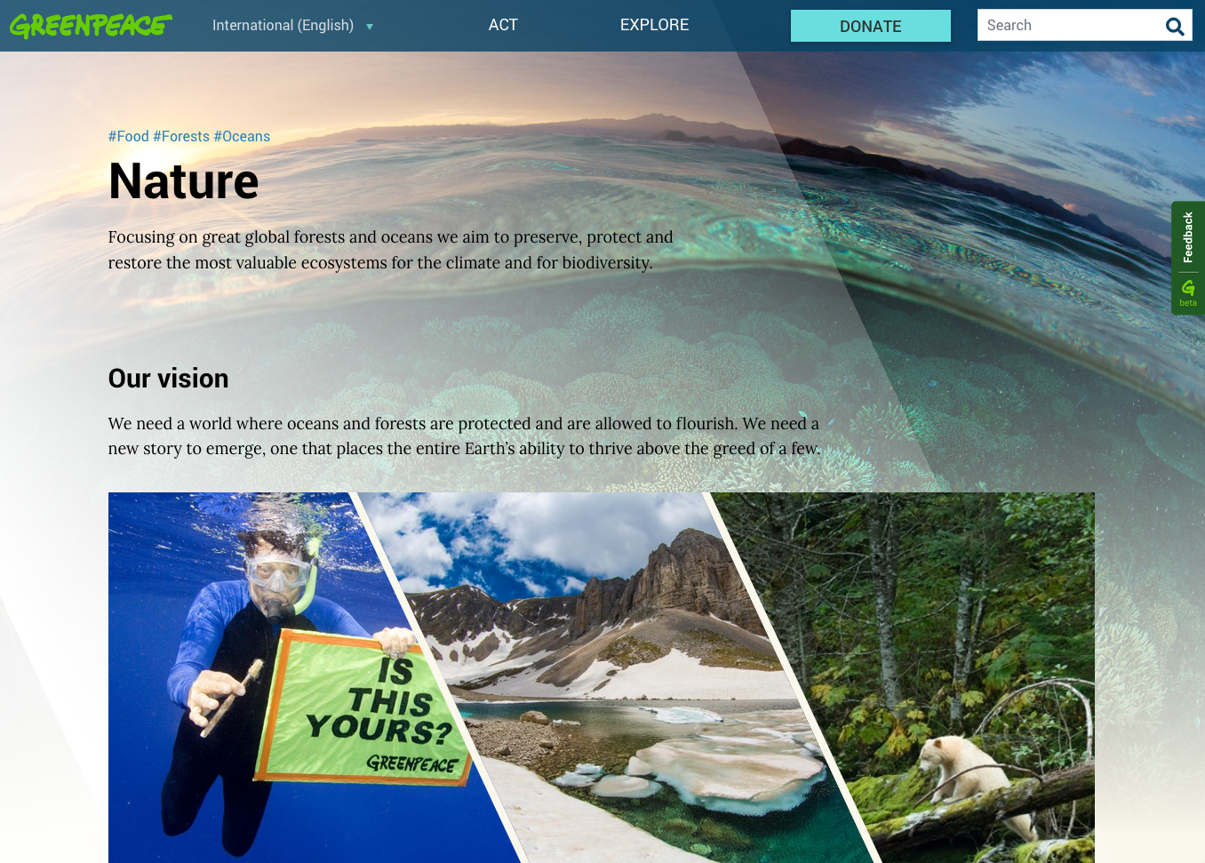
Planet 4: Built for Accessibility
Follow the standards
Device agnostic
Notes:
Our design team paid special attention to accessibility as well, and we are following appropriate standards to ensure that no matter who you are or what device you’re on, you’ll be able to engage with our content and become part of our community.
Planet 4 will be device agnostic, which means that whether on a desktop or mobile device, the experience of Greenpeace will remain the same. We designed the platform through the lens of a mobile first experience, but this does not mean it is mobile only.

Slide 22
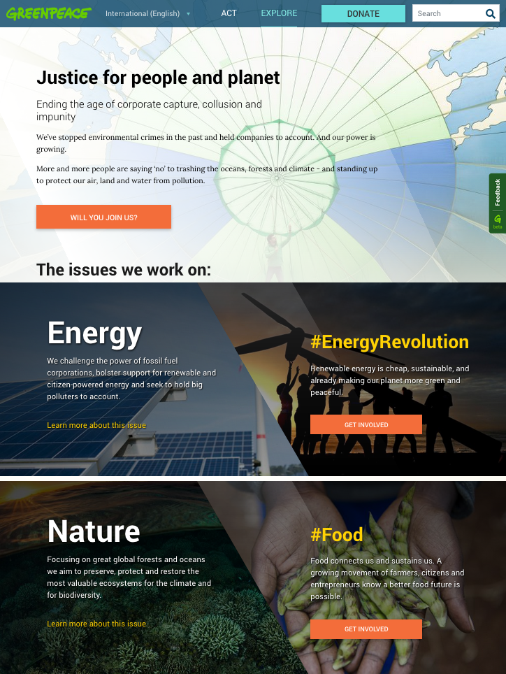
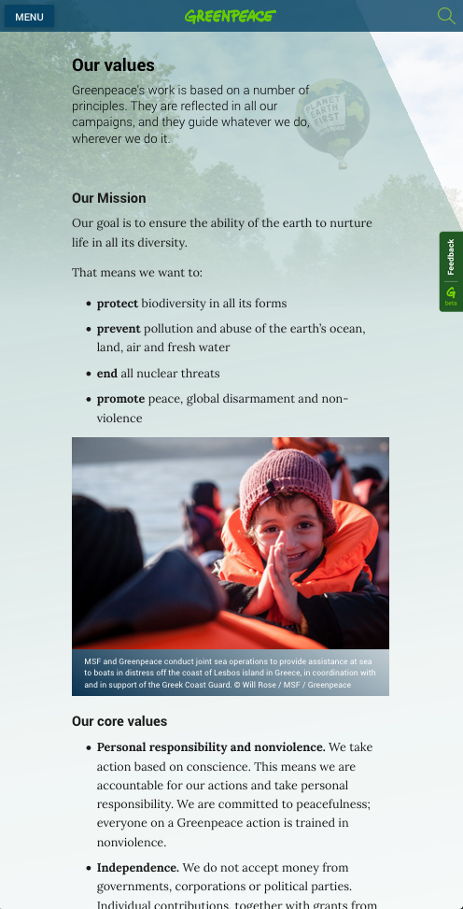
Planet 4: Shedding Light
Bearing witness and an obligation to act
Shards of light, illuminating the issues
Juxtaposing overview images with people
Notes:
One of the three Quaker principles that inspired the Greenpeace founders was about bearing witness and an obligation to act. Greenpeace is an organisation that sheds light on topics, stories and issues, and we, the people, take action.
Shedding Light is our aesthetic theory. It uses diagonal intersections and gradients to lead the user through the content. These diagonals act like shards of light illuminating a story or an issue, driving the user to explore or act. In more poetic terms, they replicate rays of light underwater or the sunlight filtering through the trees in a forest.
As well as creating diagonal flows, Shedding Light redefines how Greenpeace uses photographic content to communicate. Throughout the site we will combine issue/overview content with pictures of supporters, activists and the general public, reinforcing the notion that nothing can be saved or protected without people. In practical terms, an image of something happening in the world will be constantly juxtaposed with the people who are taking action and creating positive change.

Slide 23
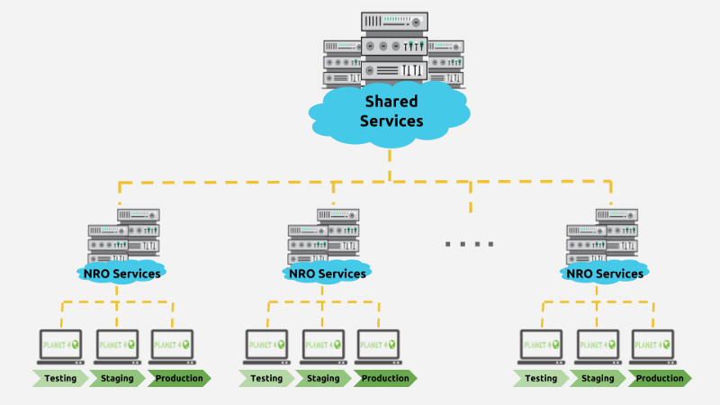

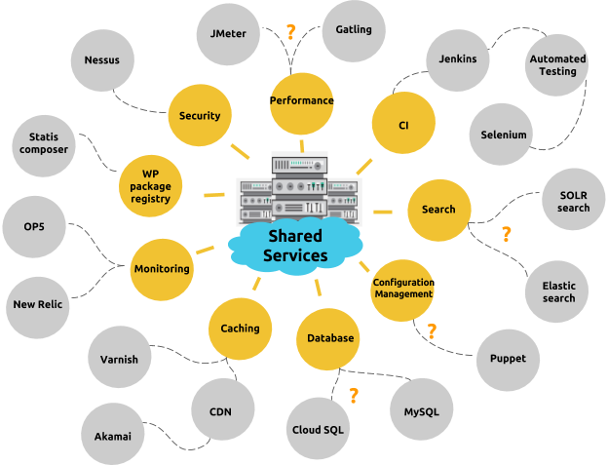
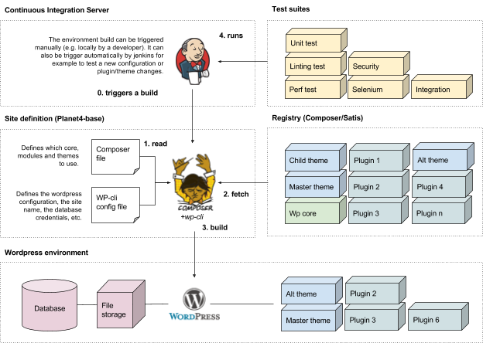
Planet 4: Innovative tech
Organic navigational structure
Tech for a global org
Built on the back of Wordpress, infra K8S
Customizable blocks
Notes:
One of the innovative features that Planet 4 will introduce is an organic navigational structure. Nowadays, the vast majority of the millions and millions of unique greenpeace.org users enter the website through social media and specific content shares. This means that direct access to (and navigation from) the home page will not drive the way we structure and push content.
In today’s web, people tend to “go down the rabbit hole”, floating in and out of content based on links and tags as opposed to global navigational structures. We have TWO buttons in our global nav.

Slide 24
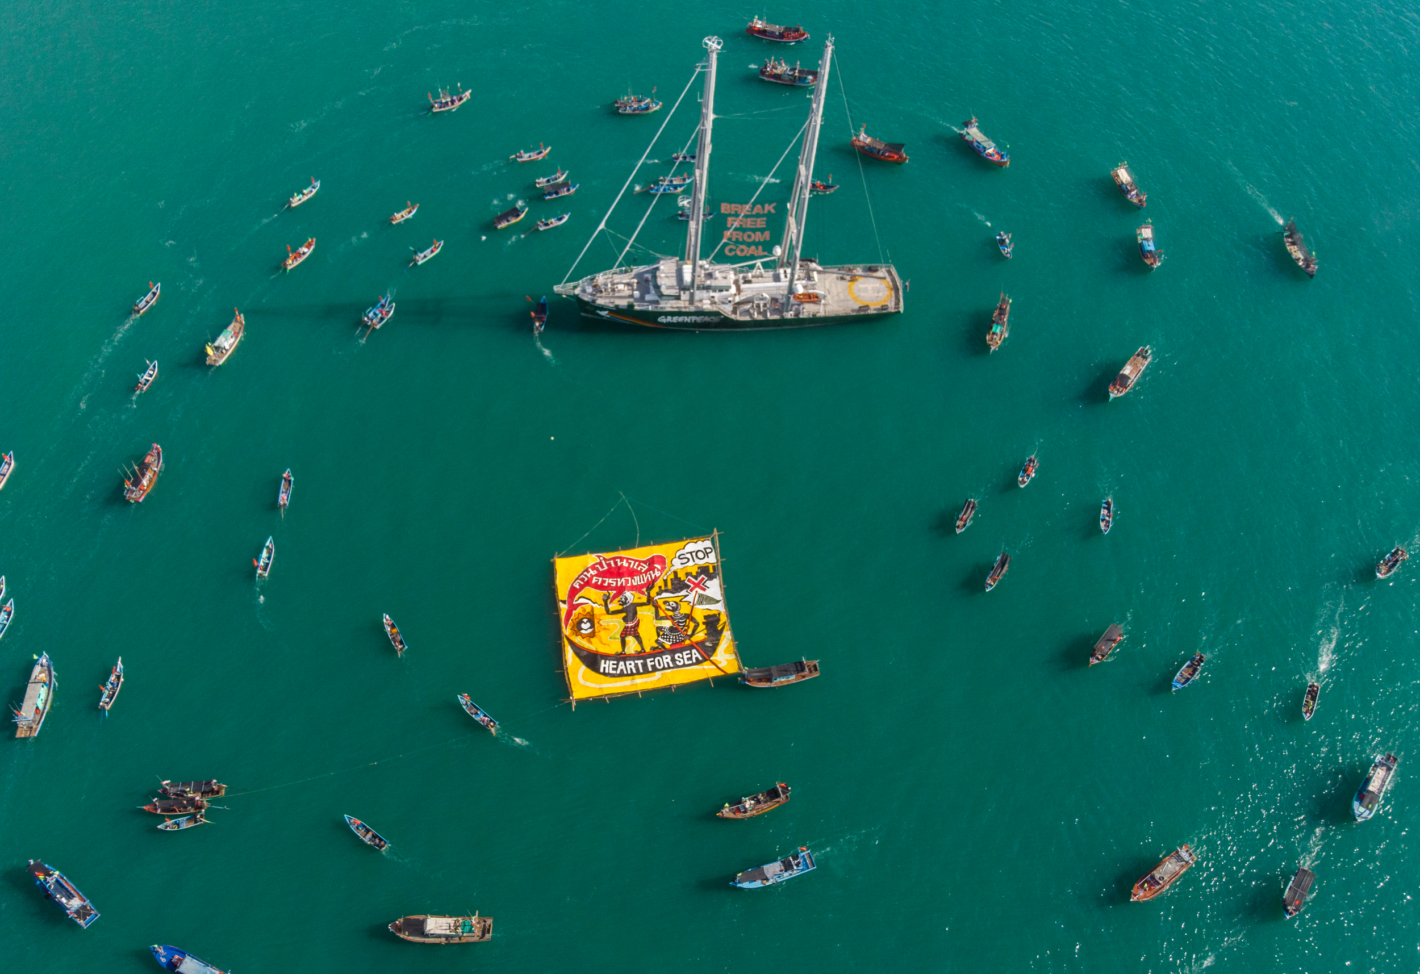




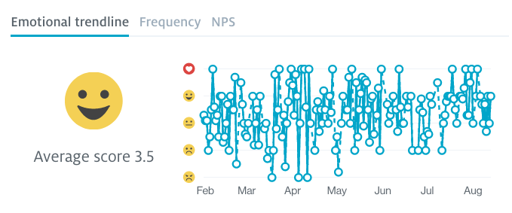
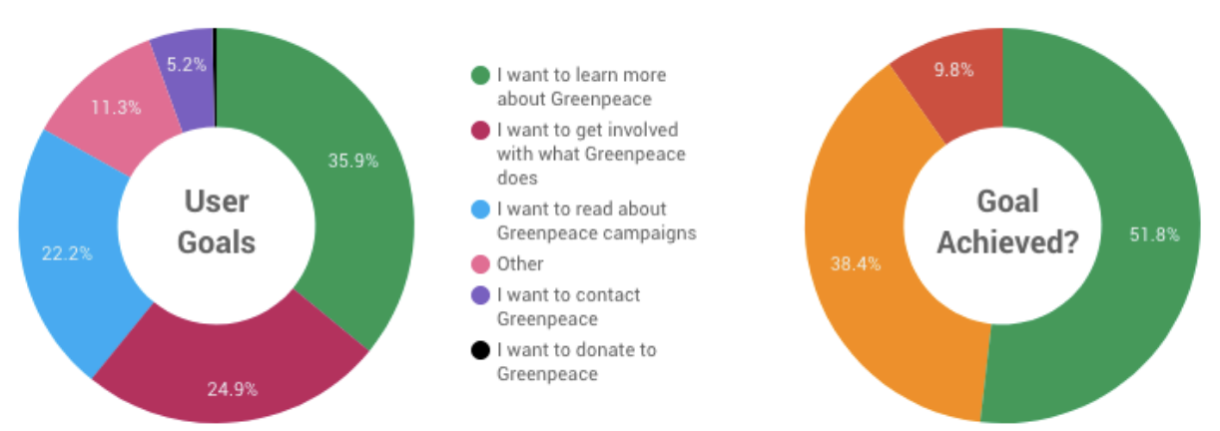
P4 is already successful
Greenpeace’s first FOSS
On top of Wordpress
Innovative Infra with K8s
Backend Modularity
Notes:
Software customizations, security audits, continuous integrations, Selenium, Jenkins, GitFlow, shared services, multi-instance approach…The Planet 4 team is creating tech for a global organization – there’s a lot to say about tech, but I’m almost out of time, and this probably isn’t the audience to get super nerdy with.
However, this platform is built on the back of Wordpress, which we contribute back to, open source, remember? Planet 4 will eventually run over 50 National and Regional Greenpeace sites. Quite simply, it is how Greenpeace will represent itself in the digital world.
I would be remiss if I didn’t say that it’s been my great pleasure working with the Planet 4 team. Over the next years we will continue to build, iterate, release, revise and remix the software we’re building.
Our users LOVE us.

Slide 25
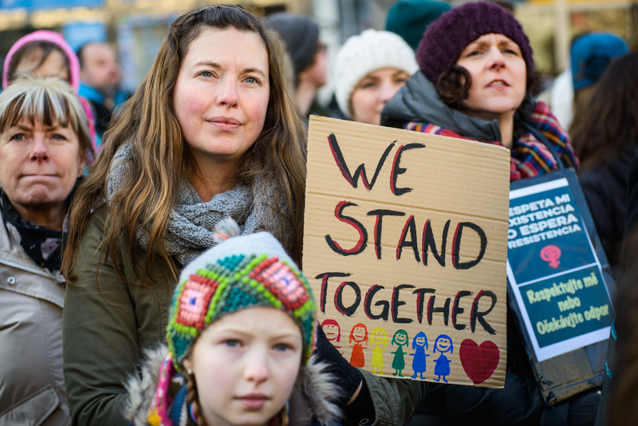
Text
© Petr Zewlakk Vrabec / Greenpeace
Notes:
We are in a place where we can live out loud and start to overcome the socially ingrained, culturally inflicted fear of failure and celebrate the messiness of human existence. We have to fail forward, learn from our mistakes and each other and recognized that as a values based organization, we have to communicate to that place where values are formed. The human heart.
In a time when dichotomies abound between the right and left. In a time of political upheaval and the us versus them mentality is part of our social fabric, idealists like me, inside of Greenpeace and out there in the world of technology and activism and art – out there in every industry actually – idealists are looking at the world and saying, you know what?
We are not in competition with each other. Let’s use the tech we have to cooperate, connect, to learn, to grow and to change the world for the better.
Thank you.
Love Trumps Hate Protest in Prague

